Slide 1
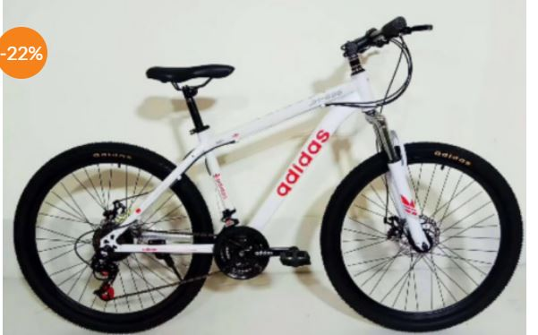
Western Countries financial data

Slide 2
Sr.no | INDEX
1) | SUMMARY ABOUT THE DATASETS
2) | STATISTICAL ANALYSIS BY SALES PRICE
3) | GRAPHICAL ANALYSIS PRODUCT BY SALES & SEGMENT BY PROFIT
4) | ANALYSIS IN SQL
5) | SALES DASHBOARD IN POWER BI

Slide 3
SUMMARY ABOUT DATASET
This is a western countries financial dataset for sales of a bicycle brand across different regions, segments, profit, discounts and yearly sales
For the purpose of analysis, we have looked into various dimension and financial metrics
We will utilize tools like power BI, SQL and EXCEL for data cleaning and to visualizing the data
We want to gain a thorough understanding of dataset and underlying insights

Slide 4
Statistical Analysis by Sales Price
It shows the average value of sales price.
It shows the max value of sales price.

Slide 5
Graphical Analysis Product by Sales & Segment by Profit
The most sale of product is paseo 28% of the customer to prefer buy paseo.
The top segment of profit is government 63%.

Slide 6
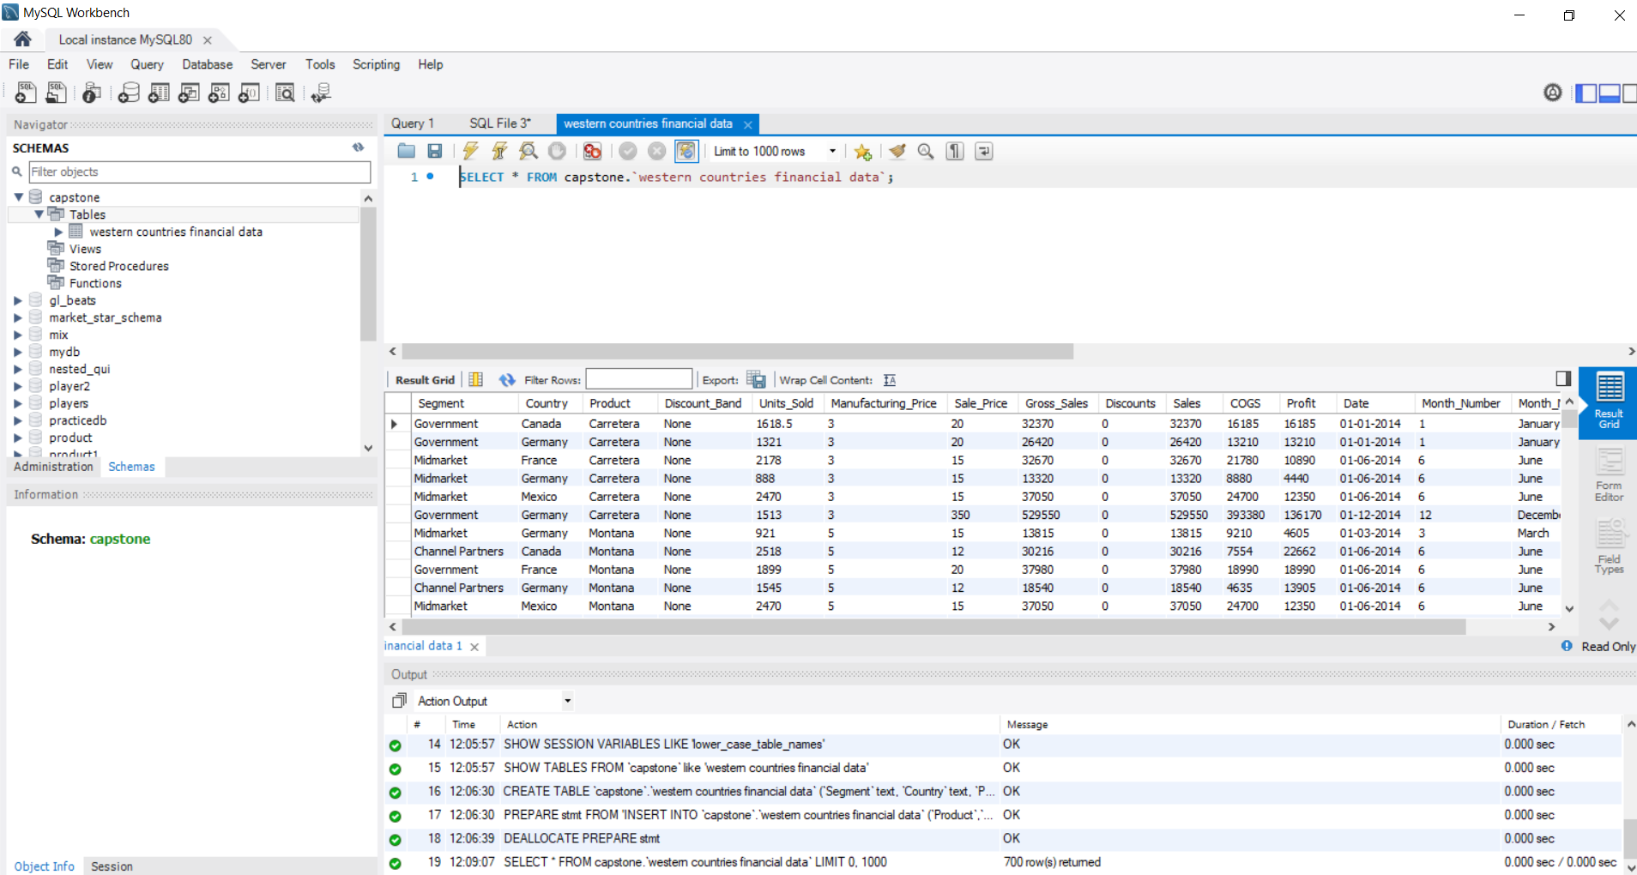
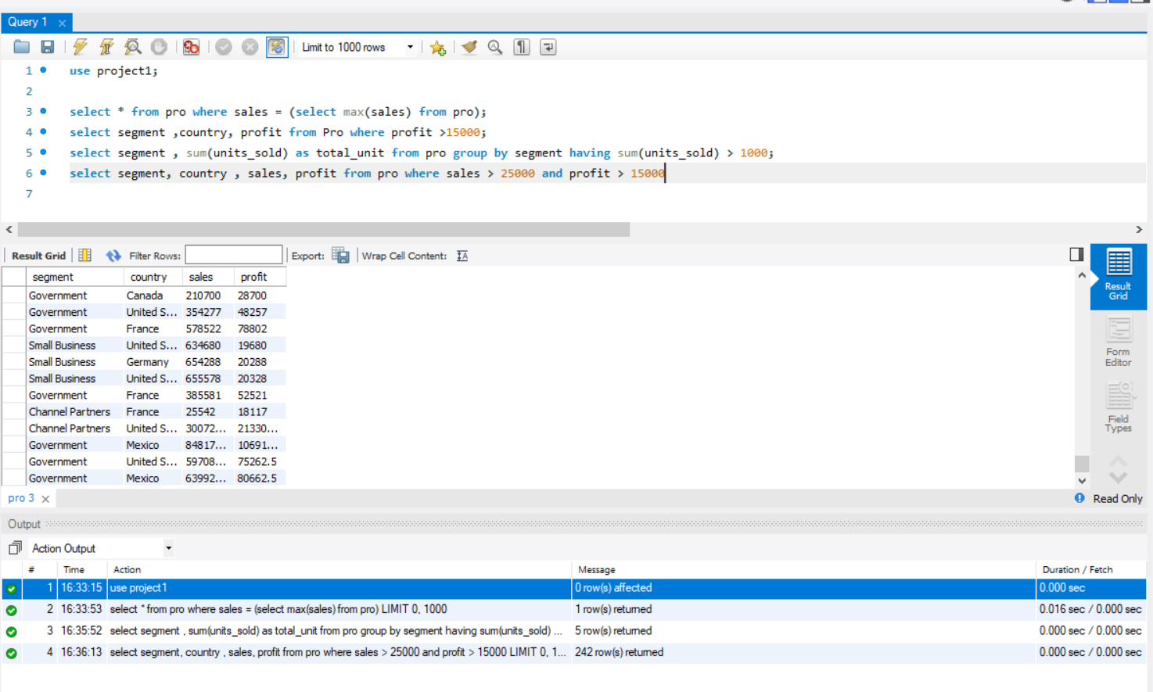
Analysis in SQL

Slide 7
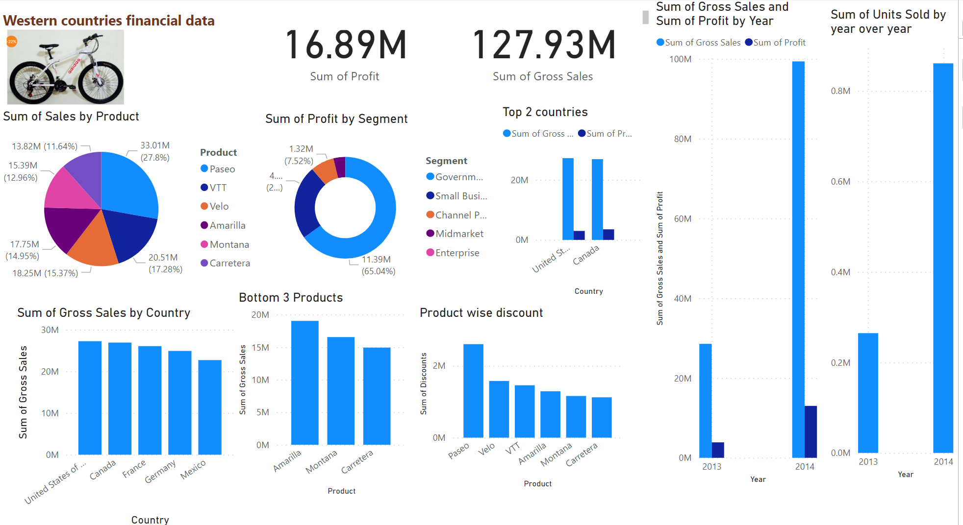
Western Countries Financial Dashboard

Slide 8
Conclusion and inference
At 33,011,143.95, Paseo had the highest Sum of Sales and was 138.95% higher than Carretera, which had the lowest Sum of Sales at 13,815,307.89.﻿﻿ ﻿﻿
﻿﻿United States of America accounted for 21.32% of Sum of Gross Sales.﻿﻿
Across all 5 Country, Sum of Gross Sales ranged from 22726935 to 27269358.﻿﻿
﻿﻿ ﻿﻿Sum of Gross Sales and total Sum of Profit are negatively correlated with each other.﻿﻿ ﻿﻿ ﻿﻿
Sum of Gross Sales and Sum of Profit diverged the most when the Country was United States of America, when Sum of Gross Sales were 24,273,817.34 higher than Sum of Profit.﻿﻿ ﻿

